Slide 1
The Art of Data Visualizations

Slide 2

5 Major Types of Big Data Visualization
Temporal
Line Plots/Scatter Plots/Timelines/Time Series
MultiDimensional
Scatter Plots/Pie Charts/Venn Diagrams/Histogram/Bar Charts
Geospatial
Heat Map/Flow Map/Density Map/Cartogram
Network
Matrix Charts/Word Clouds/Node-Link Diagrams/Alluvial Diagrams
Hierarchical
Tree Diagrams/Ring Charts

Slide 3
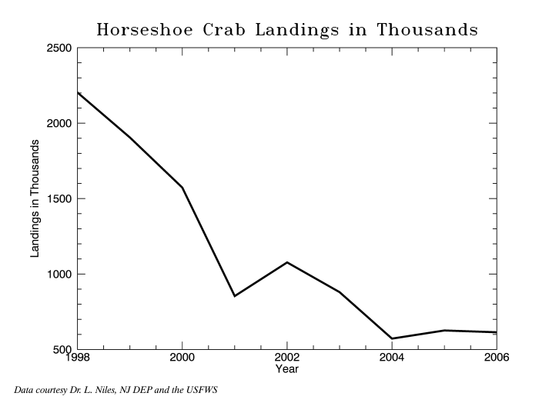
Temporal - Line Plots/Scatter Plots/Timelines/Time Series
Line charts are used to show data relative to a continuous variable most commonly time or Numbers.
Trends and Patterns
Relates to Time
2d plot

Slide 4
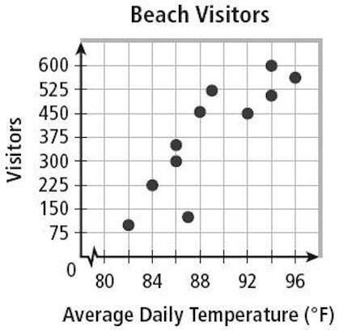
1. Temporal - Line Plots/Scatter Plots/Timelines/Time Series
Great to highlight many different data points and you want to highlight similarities in the data set.
Useful for spotting outliers

Slide 5
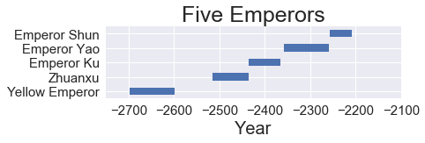
1. Temporal - Line Plots/Scatter Plots/Timelines/Time Series
Used to record events/dates in a sequential format
For project management and planning

Slide 6
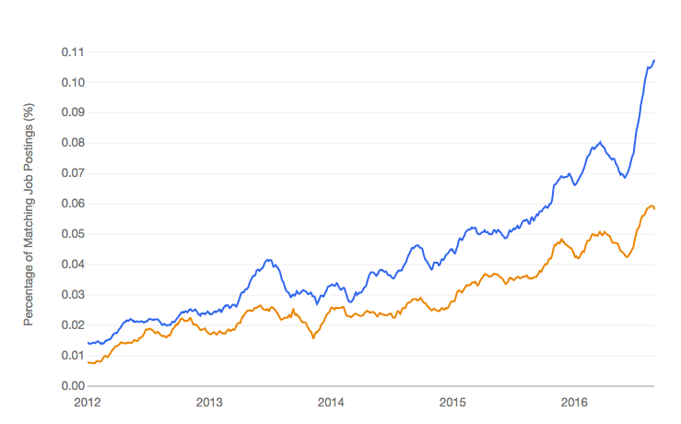
1. Temporal - Line Plots/Scatter Plots/Timelines/Time Series
A sequence of data points, measuring the same thing over time, stored in time order.
2d plot
Example: Measuring baby’s height over time

Slide 7
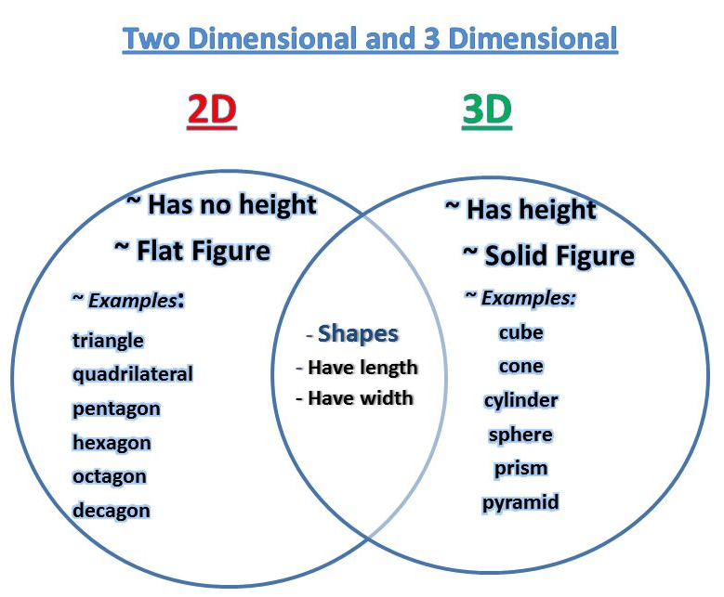
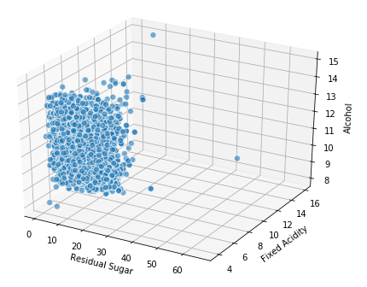
2. MultiDimensional - Scatter Plots/Pie Charts/Venn Diagrams/Histogram/Bar Charts
2D/3D variable and/or dimension to highlight many different data points and different variables
So the Z aka (Volume in Algebra) gives us a more visual and physical representation of 2d model
X (Residual Sugar), Y (Fixed Acidity), Z (Alcohol) = Height

Slide 8
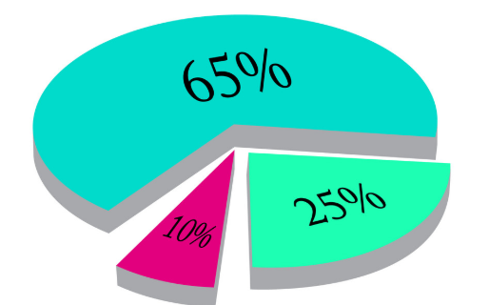
2. MultiDimensional - Scatter Plots/Pie Charts/Venn Diagrams/Histogram/Bar Charts
Good for preparing parts of a whole
Becoming obsolete

Slide 9
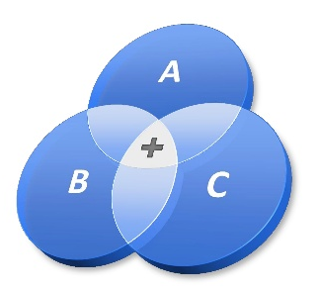
2. MultiDimensional - Scatter Plots/Pie Charts/Venn Diagrams/Histogram/Bar Charts
A Venn diagram consists of overlapping circles
Used to identify similarities, differences, and relationships between two or more sets of items

Slide 10
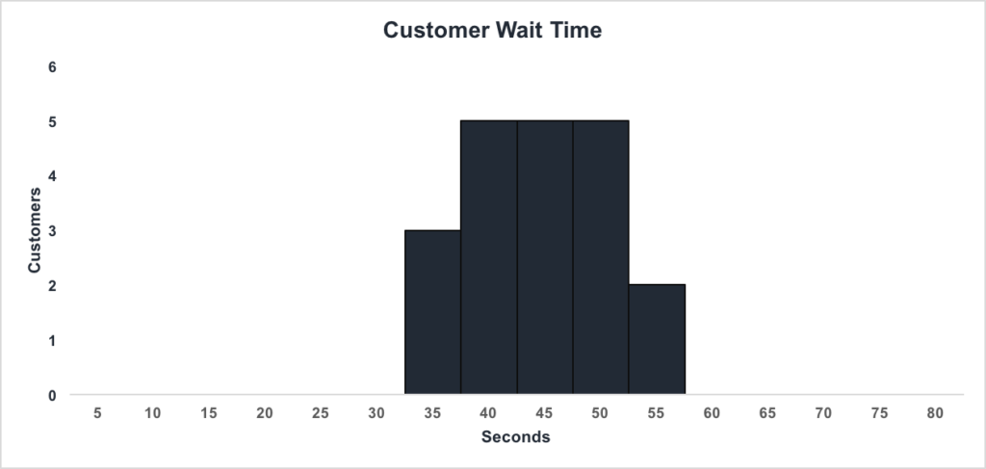
2. MultiDimensional - Scatter Plots/Pie Charts/Venn Diagrams/Histogram/Bar Charts
Mostly used to represent numerical data
Mostly used to compare data from two columns

Slide 11
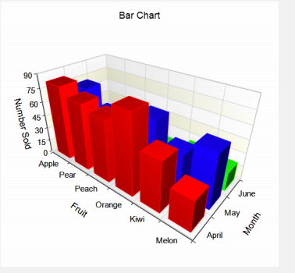
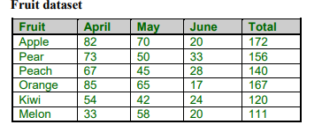
2. MultiDimensional - Scatter Plots/Pie Charts/Venn Diagrams/Histogram/Bar Charts
Compare and relate two or more values in the same category
Compare parts of a whole
X (Fruit) = Independent, Y (month) = Dependent, Z (Number Sold) Height = Covariate (mix of both)

Slide 12
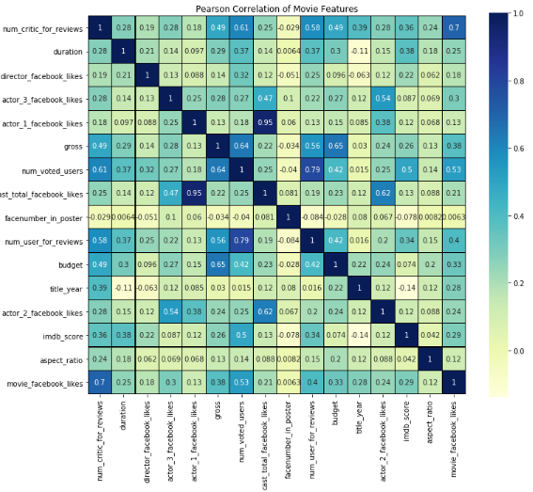
3. Geospatial - Heat Map/Flow Map/Density Map/Cartogram
Highlight correlations within datasets

Slide 13
3. Geospatial - Heat Map/Flow Map/Density Map/Cartogram
Displays the interaction data between the outflow area and the inflow area

Slide 14
3. Geospatial - Heat Map/Flow Map/Density Map/Cartogram
Highlights concentration of data in a colorful way

Slide 15
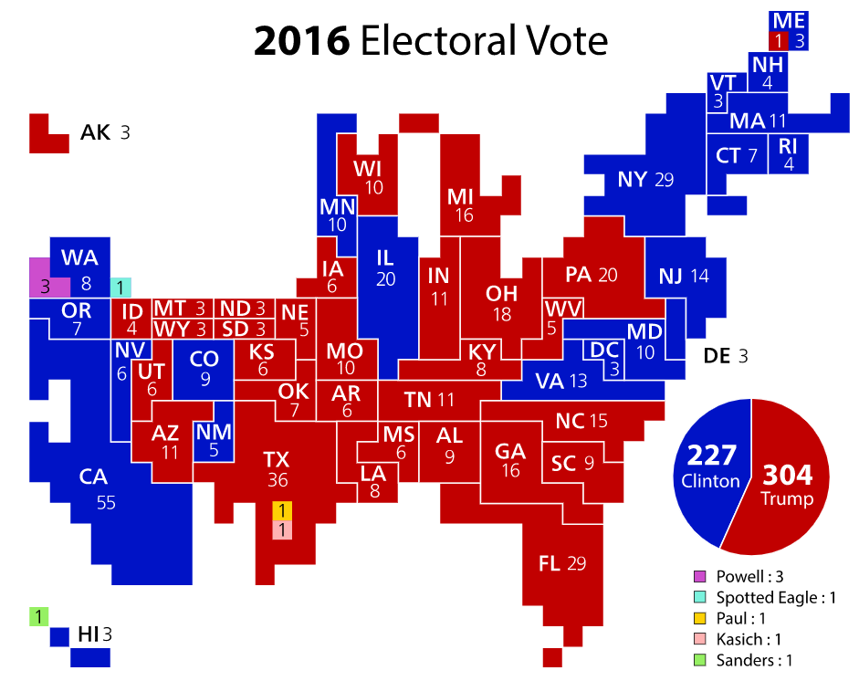
3. Geospatial - Heat Map/Flow Map/Density Map/Cartogram
A map used to combine statistical information and geographical information in a creative way

Slide 16
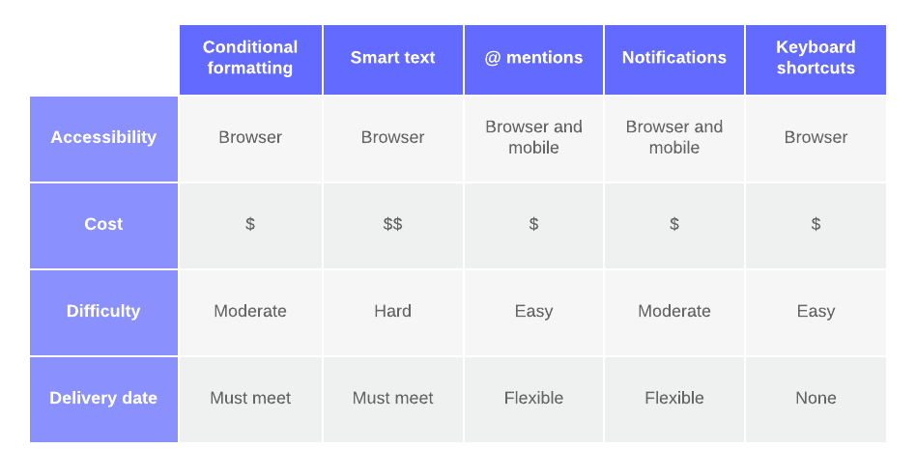
4. Network - Matrix Charts/Word Clouds/Node-Link Diagrams/Alluvial Diagrams
Show relationships between Data using rows and Columns

Slide 17
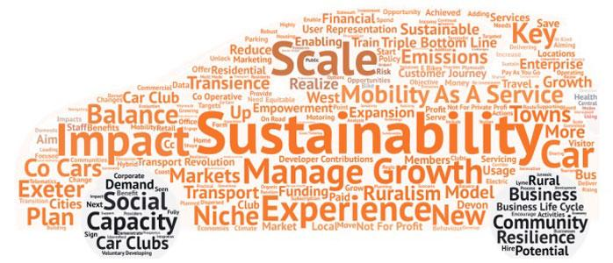
4. Network - Matrix Charts/Word Clouds/Node-Link Diagrams/Alluvial Diagrams
Used in Text analysis and Text mining to highlight character occurence

Slide 18
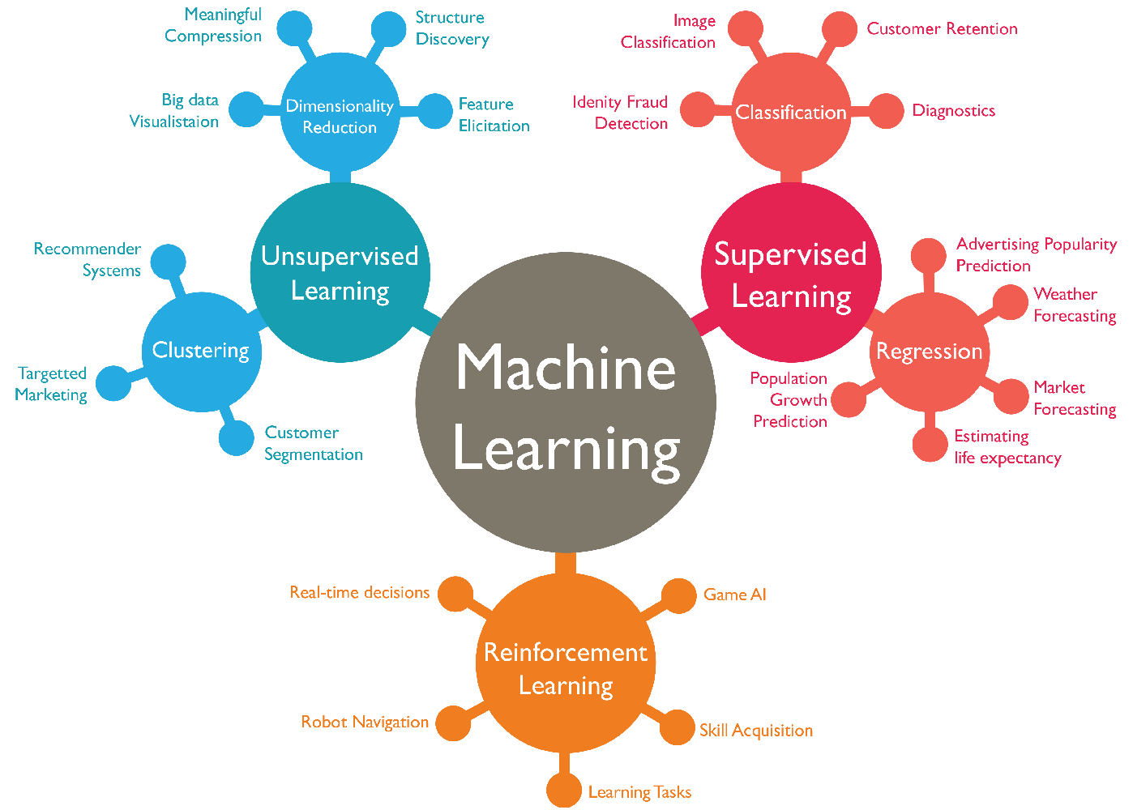
4. Network - Matrix Charts/Word Clouds/Node-Link Diagrams/Alluvial Diagrams
Used to show data interconnectedness in the form of connected lines

Slide 19
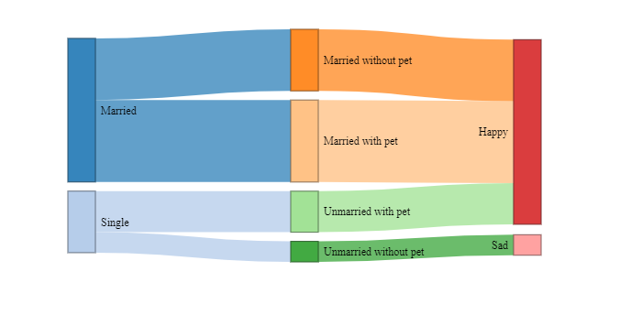
4. Network - Matrix Charts/Word Clouds/Node-Link Diagrams/Alluvial Diagrams
Best for limited data variables to show the flow of data variations

Slide 20
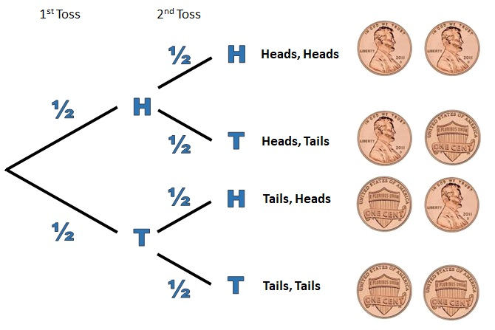
5. Hierarchical - Tree Diagrams/Ring Charts
Commonly Used in Supervised Learning to predict Probability in Machine learning decision trees and Random Forests

Slide 21
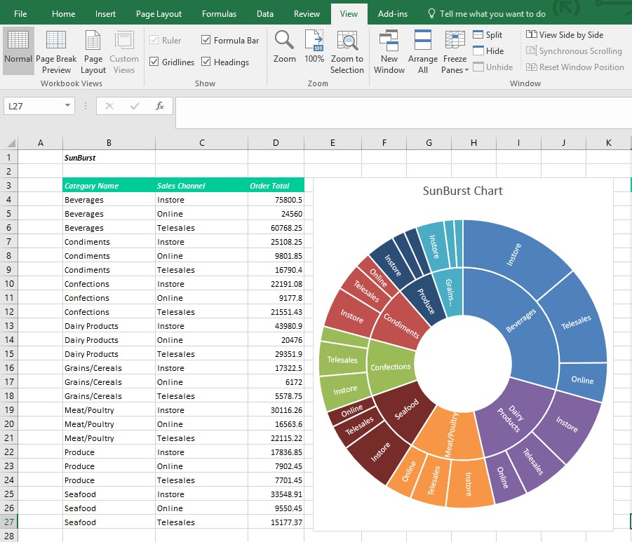
5. Hierarchical - Tree Diagrams/Ring Charts (aka Multi Level Pie chart/Sunburst Chart)
Commonly Used in Supervised Learning to predict Probability in Machine learning decision trees and Random Forests

Slide 22
LINK FOR GREAT HELP!!!
https://towardsdatascience.com/top-16-types-of-chart-in-data-visualization-196a76b54b62
klipfolio.com/resources/articles/what-is-data-visualization#DataViz10

